Slide 1
Amazon QuickSight
Sharath
sharab@amazon.com
Sr. BIE, Amazon

Slide 2
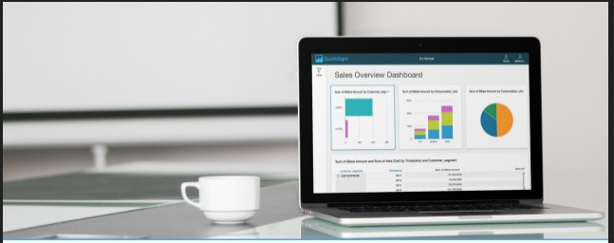
Agenda
Intro about Quicksight.
Getting access and Connecting to Quicksight.
Creating Datasets and Analysis.
Understanding various parts of Analysis page.
Field wells
Sheets
Visualize
Filters
Parameters
Calculated fields
Formatting
Analysis/Dashboard sharing and scheduling the reports

Slide 3
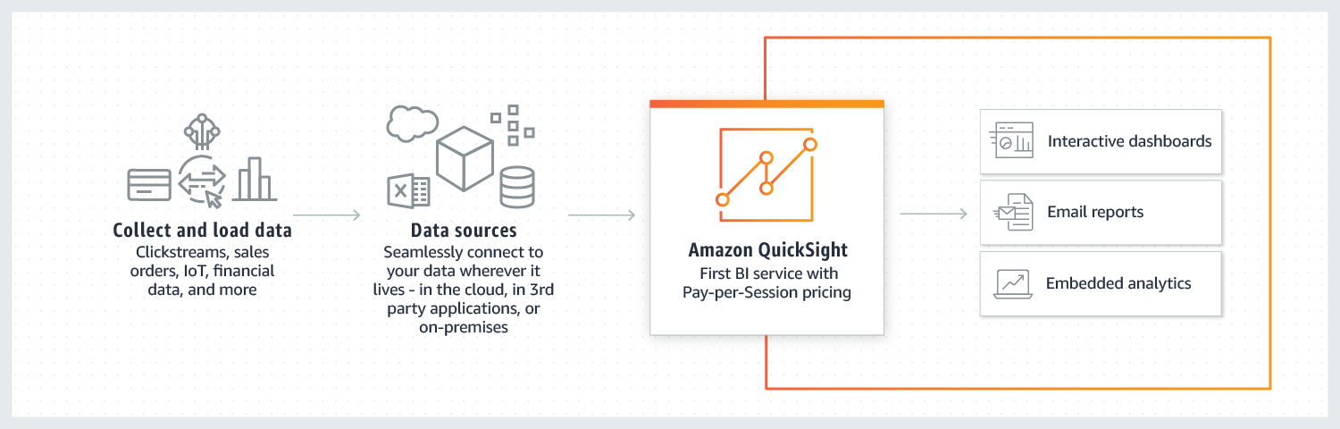
What is Quicksight and How it works?
Amazon QuickSight is a Business Analytics Service that lets business users quickly and easily visualize, explore, and share insights from their data.

Slide 4
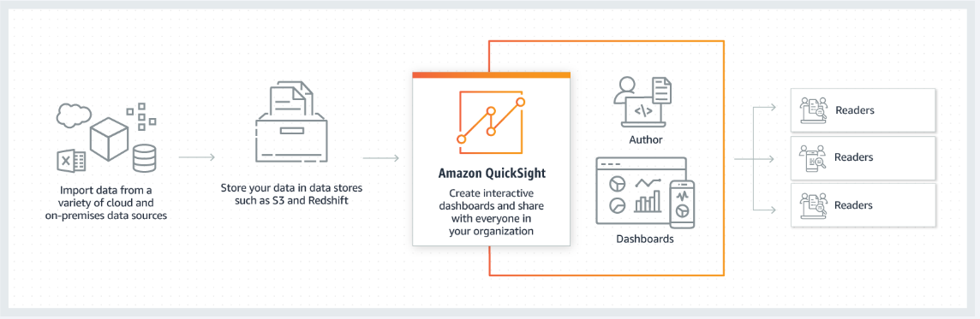
What it is used for? To provide interactive dashboards
Companies often rely on writing complex ad-hoc SQL queries or manually sending static spreadsheets to share data and insights. QuickSight’s pay-per-session pricing and serverless architecture enable you to deliver insights to everyone in your organization. With QuickSight, you can share rich and interactive dashboards with all your users, allowing them to drill-down and explore the data to answer their questions and gain relevant insights.

Slide 5
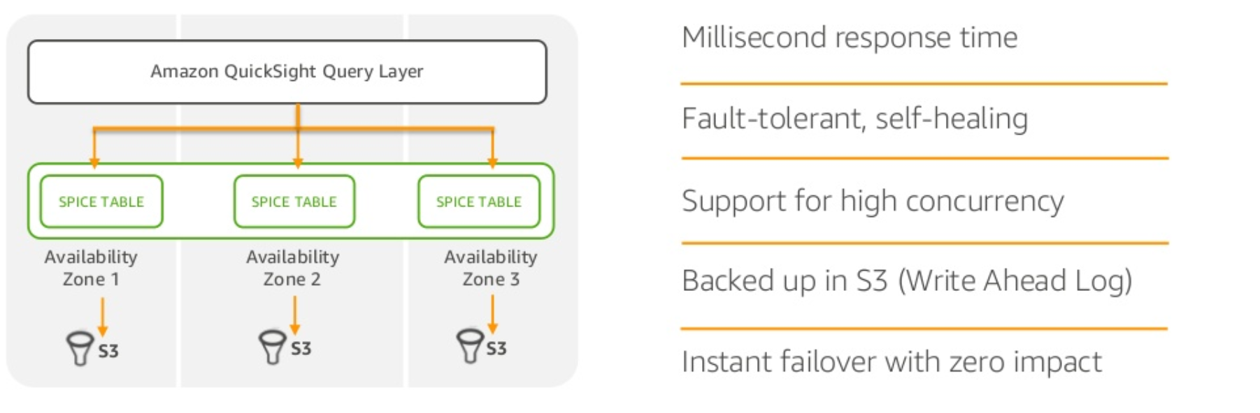
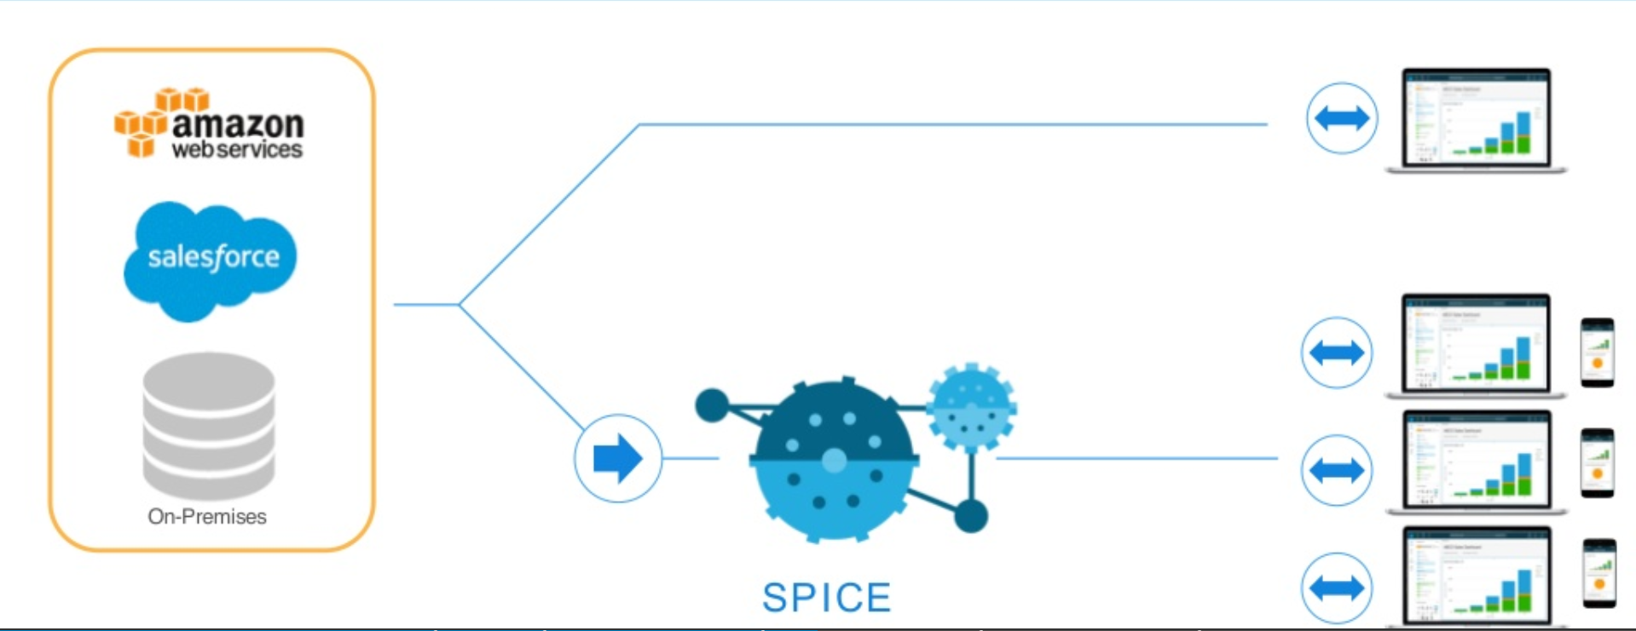
Where it runs on? SPICE ENGINE

Slide 6
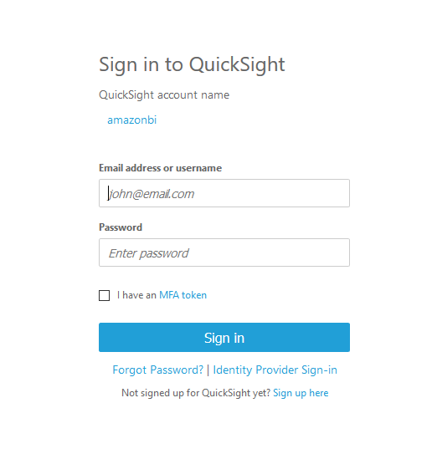
Getting access and Connecting to Quicksight.
Quicksight has 2 types of account
Amazon QuickSight Standard edition
Amazon QuickSight Enterprise edition
Link : https://us-east-1.quicksight.aws.amazon.com/sn/start
QuickSight account name : amazonbi
By default all Amazonian have reader access to amazonbi account and single sign on.
For Author permission : Manager approval https://permissions.amazon.com/group.mhtml?target=11640633

Slide 7


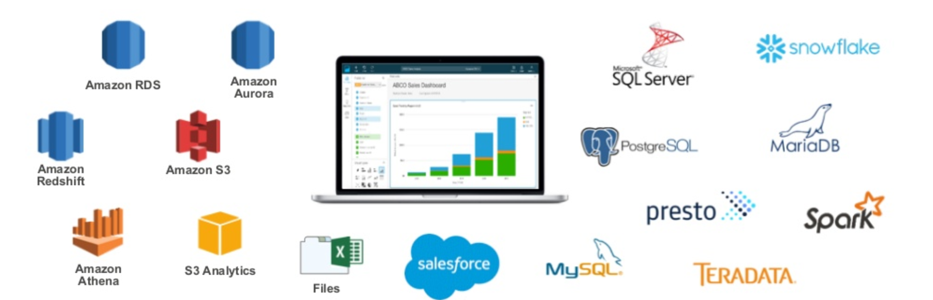

Connect Datasets
Amazon QuickSight is deeply integrated with AWS data sources such as Amazon Redshift, RDS, Aurora, Athena and S3, cloud applications like Salesforce, flat file sources, as well as many on-premises databases and big data technologies.
For today we will be focusing on redshift

Slide 8
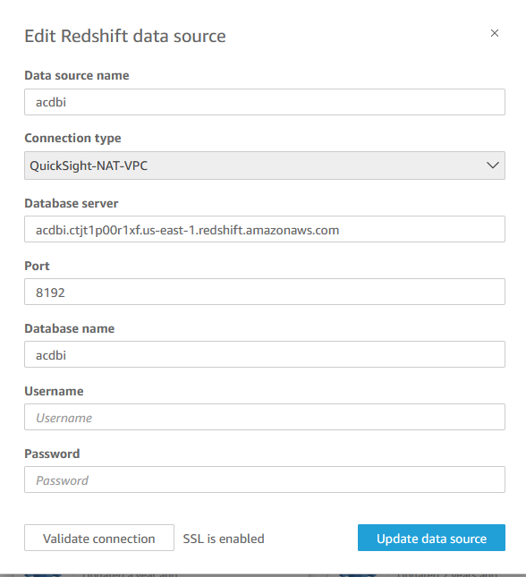
Creating Redshift Dataset
For redshift connections
Data source name: acdbi
URL: acdbi.ctjt1p00r1xf.us-east-1.redshift.amazonaws.com
Port : 8192
Database: acdbi
User: quicksight_demo
Password: Md5d4sdgtd5b
This user will be deleted by end of the day, please reach out to CDO BI team using SIM

Slide 9
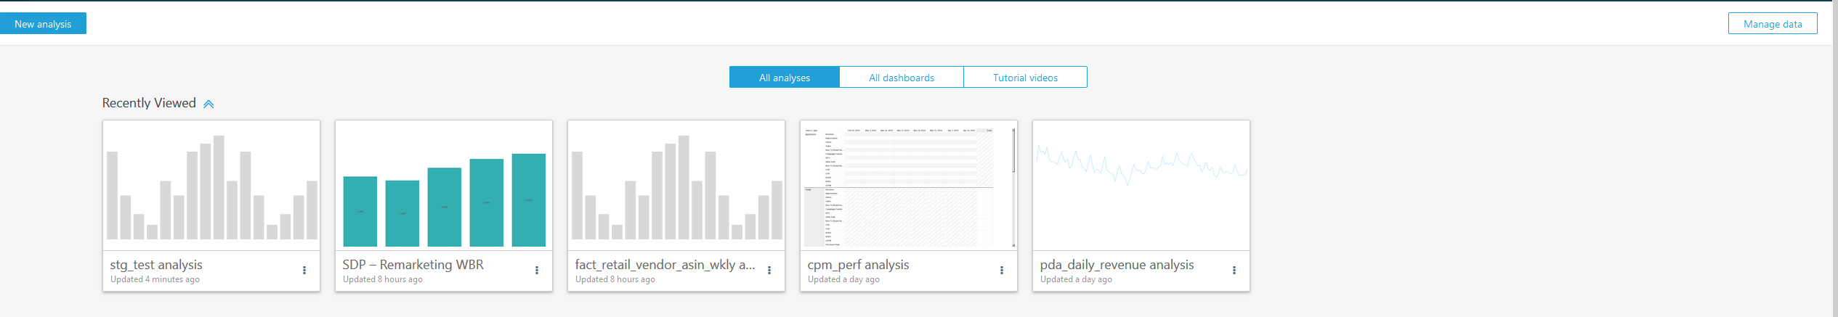


Creating Analysis
After creating the data set click on New analysis

Slide 10
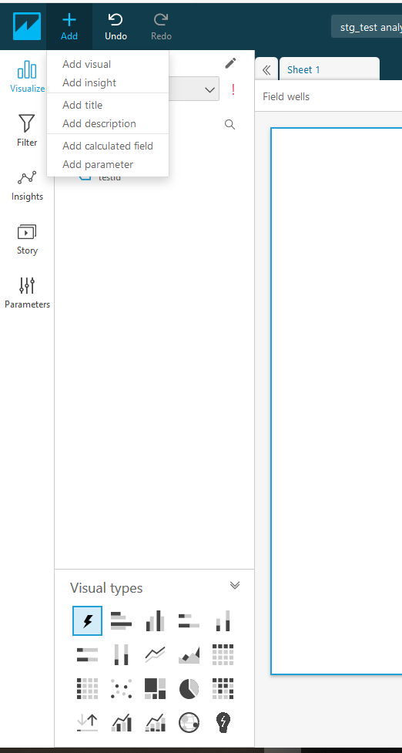
Various parts of Analysis page.
Visualize
Fields List Pane
Visual types
Data Set
Sheets
Field wells
Filters
Parameters
Calculated fields
Formatting
More details can be found here : https://docs.aws.amazon.com/quicksight/latest/user/welcome.html

Slide 11
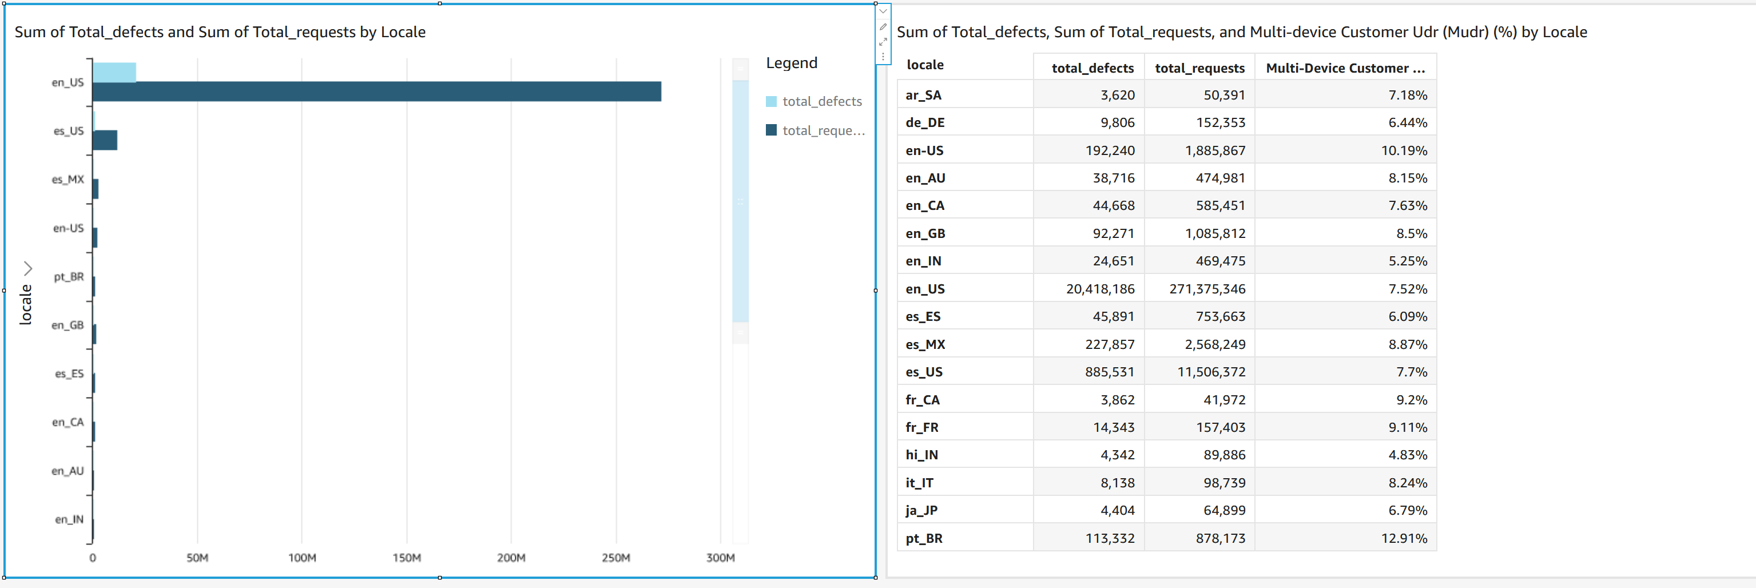
QS_demo_VDR_dashboard
https://us-east-1.quicksight.aws.amazon.com/sn/dashboards/740400c1-f1fc-4829-a737-c188725cda9f

Slide 12
Steps to create the Dashboard
First create a Anlayse
Click on New Analysis
Choose from the existing dataset , since it will be your the first time, use create New data set
Choose the needed table. In this case , public schema and Voice_Defect_Reduction_QS_demo_new table and click on visualize and wait for data to be imported into spice.

Slide 13
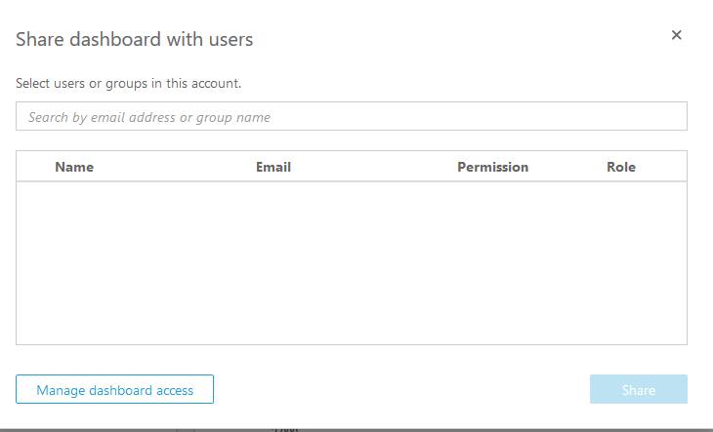
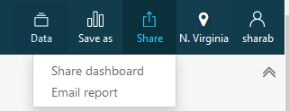
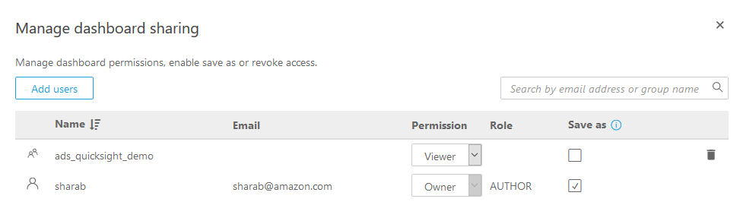
Analysis/Dashboard sharing and scheduling the reports
Click on Share and click on manage dashboard access.

Slide 14
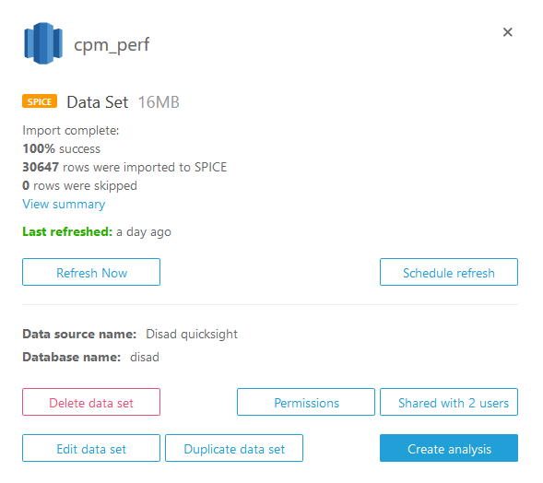
Scheduling Refresh
Go the Mange data.
Choose the data needs to refreshed.
A pop up as in the image will be appear.
Click on Schedule refresh.
Choose the date and time and click create.

Slide 15
Unique use case of QuickSight
We all know Quicksight is useful for Dash boarding , few other uses case could be
Use case 1: Have more than 1MM rows of data and want to share to others ??
Use case 2: Have a report needs to published on a regular cadence, currently using windows shared folder to publish ??
Use case 3: Have a Amazon metric job??
Use case 4: Using Hubble to see what data is available in your cluster ??

Slide 16
Resource
https://docs.aws.amazon.com/quicksight/latest/user/welcome.html
Distribution list : quicksight-users@amazon.com
https://w.amazon.com/index.php/QuickSight%20Wiki/InternalCustomerOnboarding
https://w.amazon.com/index.php/QuickSight%20Wiki/QuickSightOfficeHours
https://us-east-1.quicksight.aws.amazon.com/sn/tutorial-videos
Feel free to ping me on slack

Slide 17
Q & A

